Slide 1
Cornerstone City Church Peninsula Plus Community Hoo Are Ya
4th January 2026

Slide 2
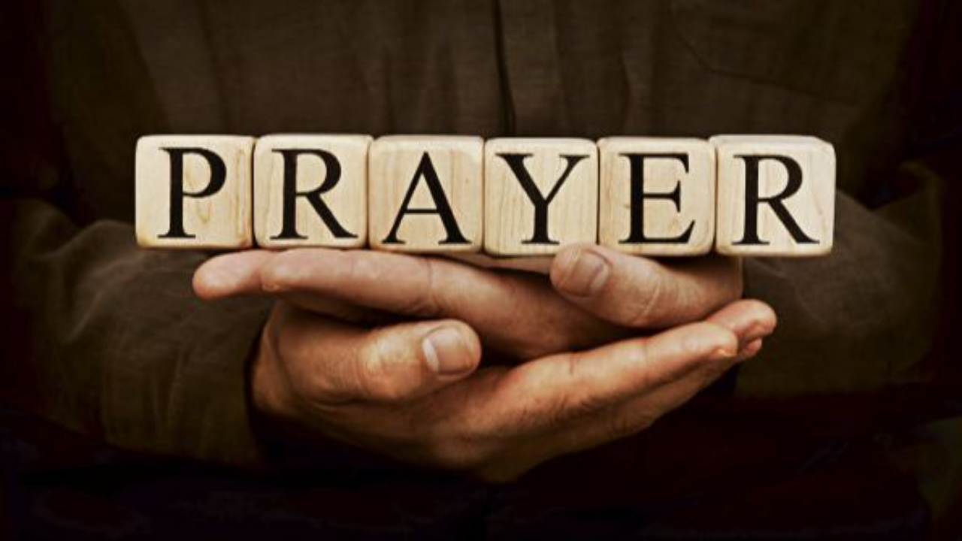

Slide 3
Great Big God
CCLI Song # 3373437
Jo Hemming | Nigel Hemming
© 2001 Vineyard Songs (UK/Eire) (Admin. by Integrity Music Ltd)
For use solely with the SongSelect® Terms of Use. All rights reserved. www.ccli.com
CCLI Licence No. 33265

Slide 4
1/2
Our God is a great big God
Our God is a great big God
Our God is a great big God
And He holds us in His hands

Slide 5
2/2
He's higher than a skyscraper
And He's deeper than a submarine
He's wider than the universe
And beyond my wildest dreams
And He's known me and He's loved me
Since before the world began
How wonderful to be a part of
God's amazing plan

Slide 6
This Is Amazing Grace
CCLI Song # 6333821
Jeremy Riddle | Josh Farro | Phil Wickham
© 2012 WC Music Corp. (Admin. by / Small Stone Media BV, Holland (Admin. in the UK/Eire by Song Solutions www.songsolutions.org))
Bethel Music Publishing (Admin. by Song Solutions)
Phil Wickham Music (Admin. by Song Solutions www.songsolutions.org)
Seems Like Music (Admin. by Song Solutions www.songsolutions.org)
Sing My Songs (Admin. by Song Solutions www.songsolutions.org)
For use solely with the SongSelect® Terms of Use. All rights reserved. www.ccli.com
CCLI Licence No. 33265

Slide 7
1/8
Who breaks the power of sin and darkness
Whose love is mighty and so much stronger
The King of Glory the King above all kings

Slide 8
2/8
Who shakes the whole earth with holy thunder
And leaves us breathless in awe and wonder
The King of Glory the King above all kings

Slide 9
3/8
This is amazing grace
This is unfailing love
That You would take my place
That You would bear my cross
You laid down Your life
That I would be set free
Oh Jesus I sing for all that You've done for me

Slide 10
4/8
Who brings our chaos back into order
Who makes the orphan a son and daughter
The King of Glory the King of Glory

Slide 11
5/8
Who rules the nations with truth and justice
Shines like the sun in all of its brilliance
The King of Glory the King above all kings

Slide 12
6/8
This is amazing grace
This is unfailing love
That You would take my place
That You would bear my cross
You laid down Your life
That I would be set free
Oh Jesus I sing for all that You've done for me

Slide 13
7/8
Worthy is the Lamb who was slain
Worthy is the King who conquered the grave
Worthy is the Lamb who was slain
Worthy is the King who conquered the grave
Worthy is the Lamb who was slain
Worthy is the King who conquered the grave
Worthy is the Lamb who was slain
Worthy worthy worthy

Slide 14
8/8
This is amazing grace
This is unfailing love
That You would take my place
That You would bear my cross
You laid down Your life
That I would be set free
Oh Jesus I sing for all that You've done for me

Slide 16
Open The Eyes of My Heart
CCLI Song # 2298355
Paul Baloche
© 1997 Integrity's Hosanna! Music (Admin. by Integrity Music Ltd)
For use solely with the SongSelect® Terms of Use. All rights reserved. www.ccli.com
CCLI Licence No. 33265

Slide 17
1/3
Open the eyes of my heart Lord
Open the eyes of my heart
I want to see You
I want to see You

Slide 18
2/3
To see You high and lifted up
Shining in the light of Your glory
Pour out Your power and love
As we sing holy holy holy

Slide 19
3/3
Holy holy holy
Holy holy holy
Holy holy holy
I want to see You

Slide 21
How Great Is Our God
CCLI Song # 4348399
Chris Tomlin | Ed Cash | Jesse Reeves
© 2004 sixsteps Music (Admin. by Integrity Music Ltd)
Vamos Publishing (Admin. by Integrity Music Ltd)
worshiptogether.com songs (Admin. by Integrity Music Ltd)
Wondrously Made Songs (Admin. by Song Solutions www.songsolutions.org)
For use solely with the SongSelect® Terms of Use. All rights reserved. www.ccli.com
CCLI Licence No. 33265

Slide 22
1/6
The splendour of the King
Clothed in majesty
Let all the earth rejoice
All the earth rejoice
He wraps Himself in light
And darkness tries to hide
And trembles at His voice
And trembles at His voice

Slide 23
2/6
How great is our God
Sing with me
How great is our God
And all will see how great
How great is our God

Slide 24
3/6
And age to age He stands
And time is in His hands
Beginning and the End
Beginning and the End
The Godhead three in one
Father Spirit Son
The Lion and the Lamb
The Lion and the Lamb

Slide 25
4/6
How great is our God
Sing with me
How great is our God
And all will see how great
How great is our God

Slide 26
5/6
Name above all names
Worthy of all praise
My heart will sing
How great is our God

Slide 27
6/6
How great is our God
Sing with me
How great is our God
And all will see how great
How great is our God

Slide 28


Slide 29
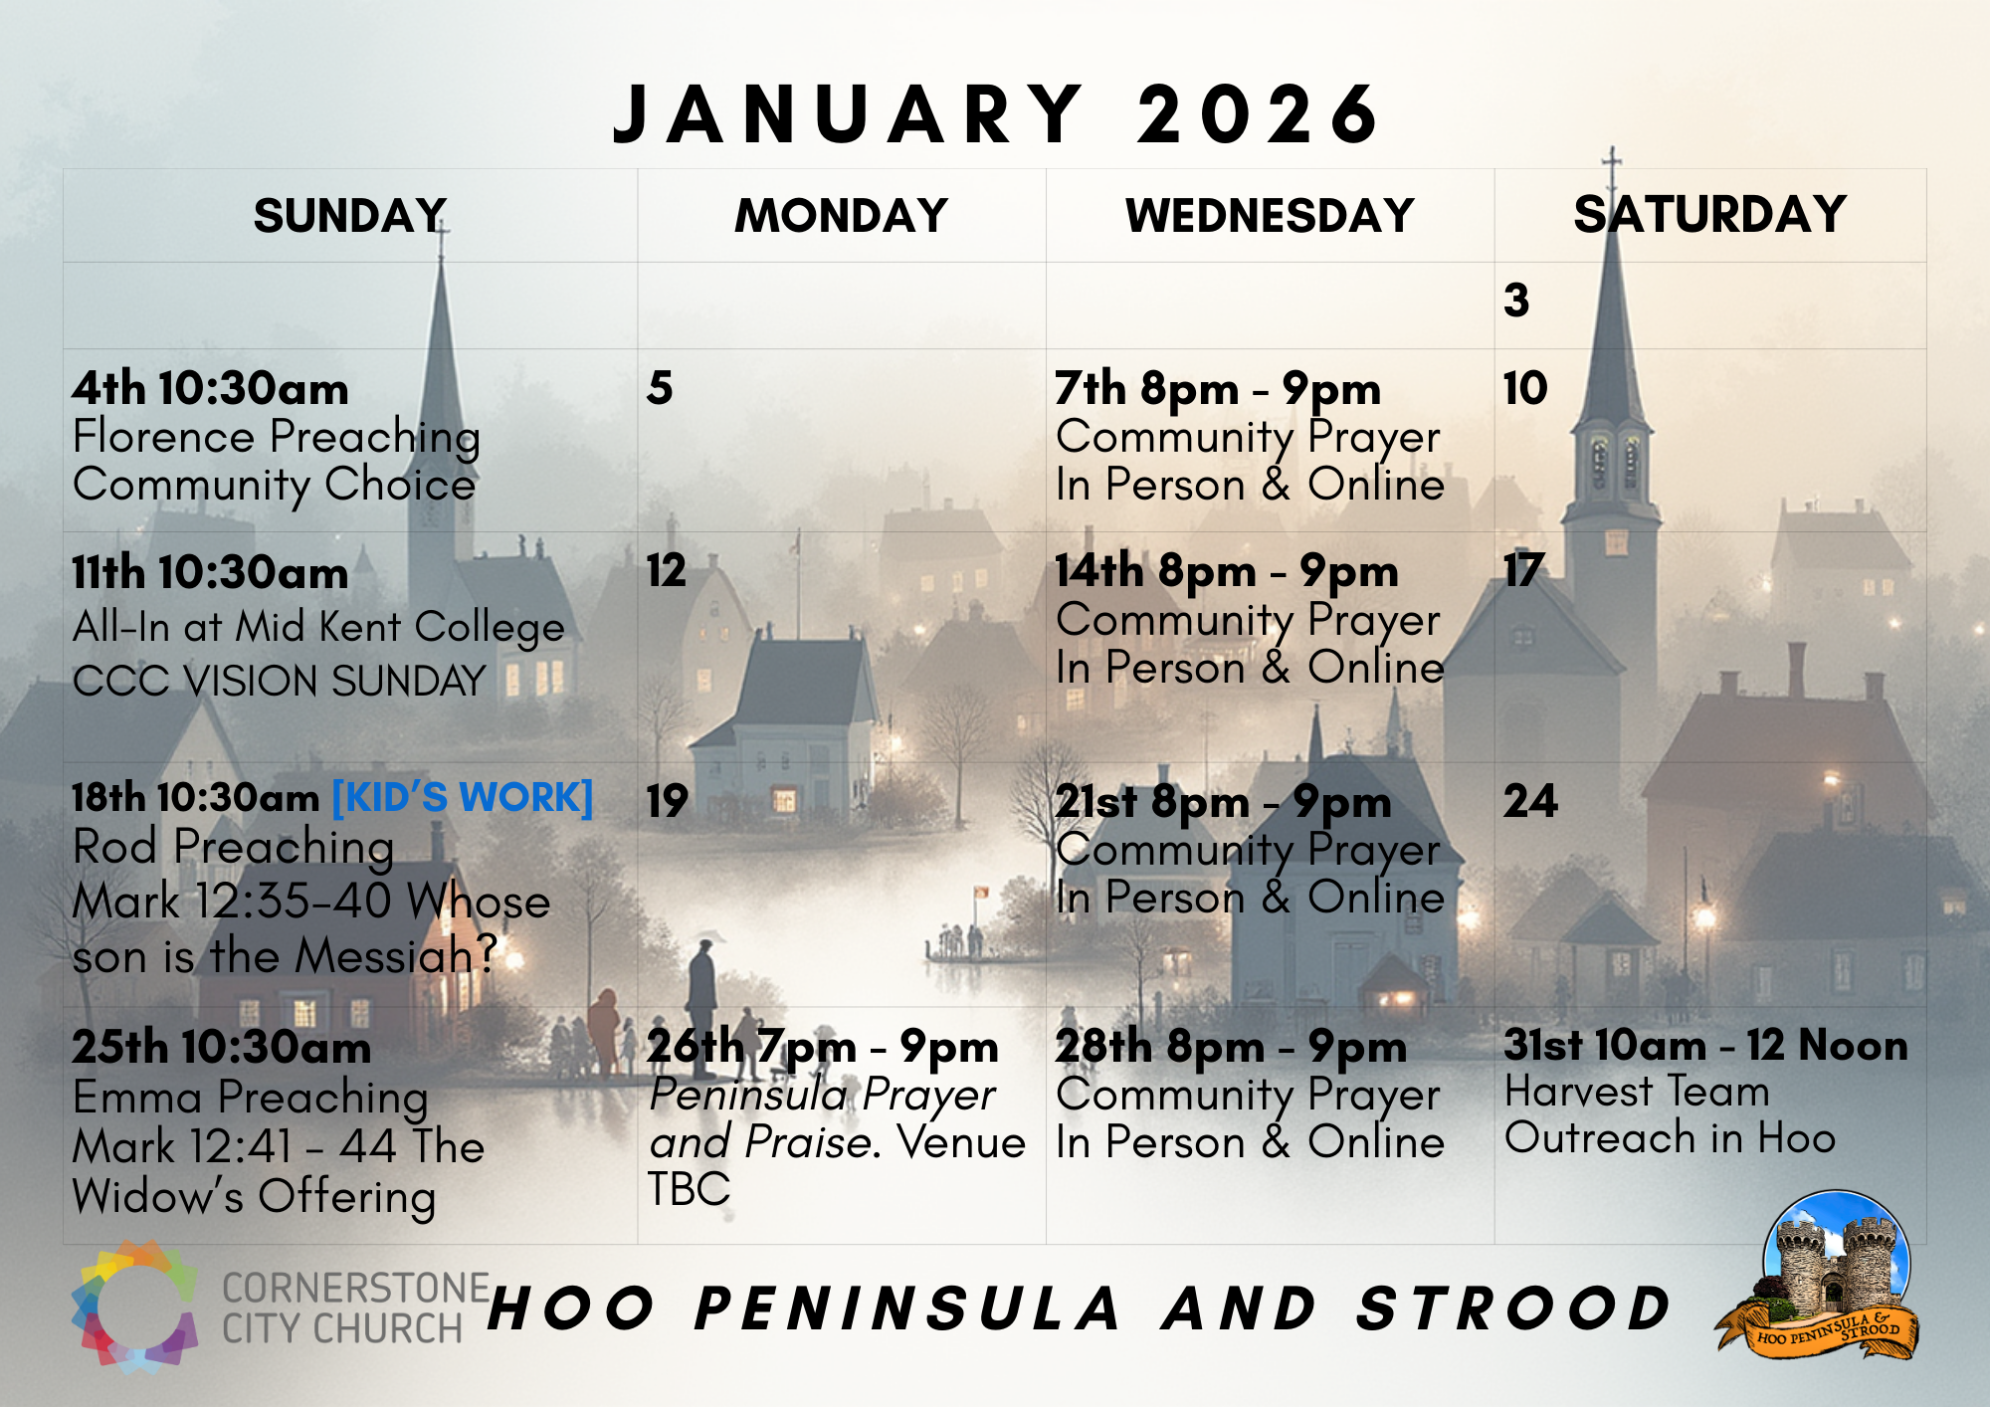

Slide 30


Slide 31
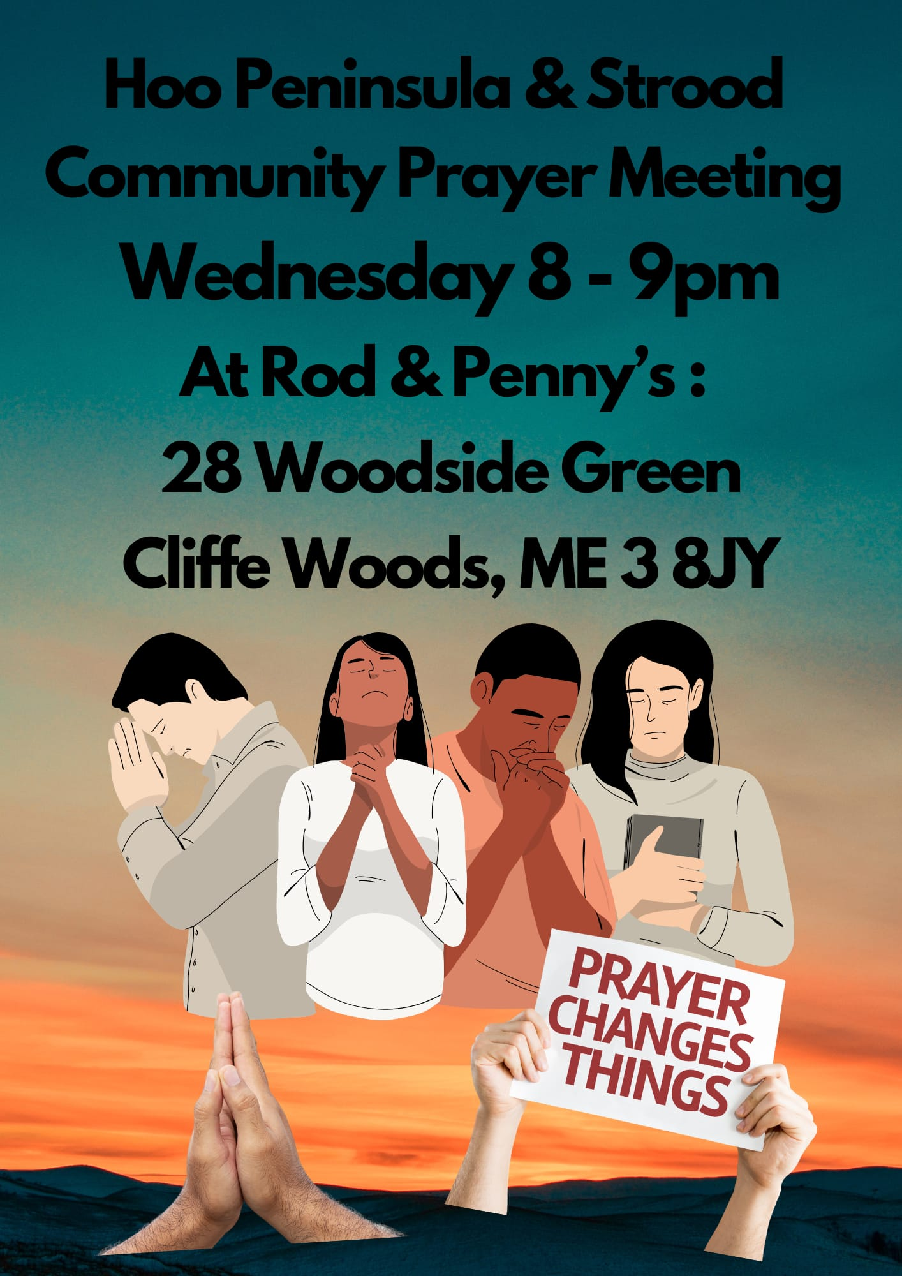

Slide 32
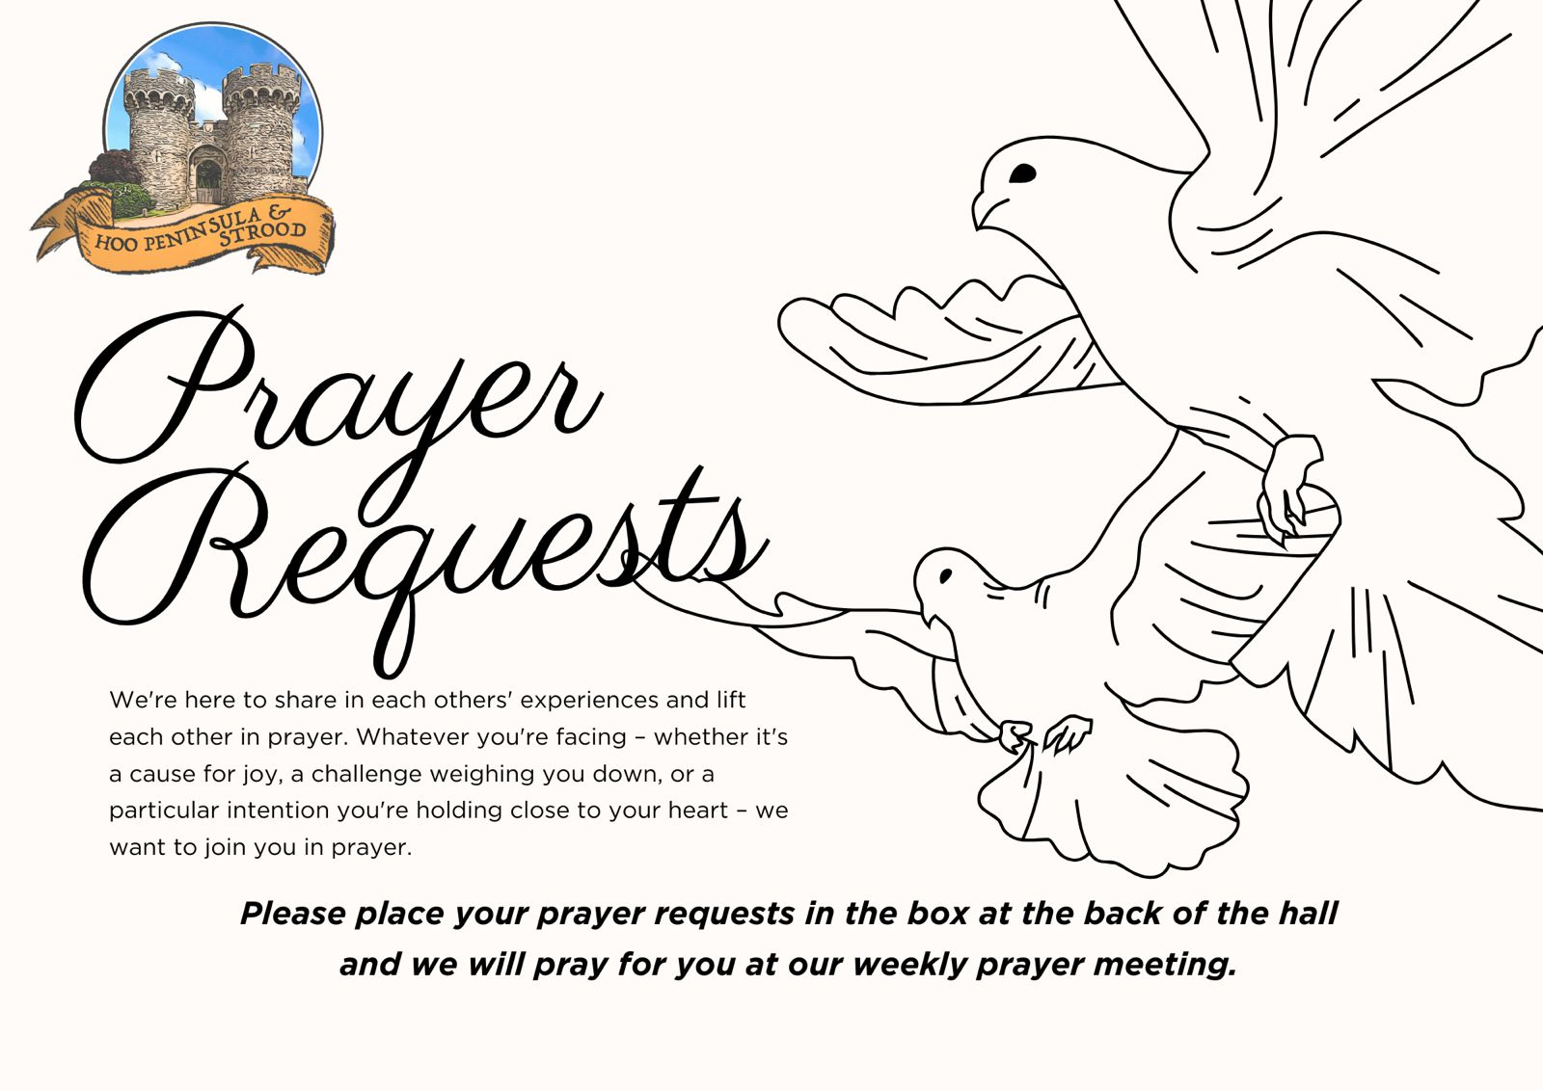

Slide 33


Slide 34


Slide 35


Slide 36
2 Corinthians 14 May the grace of the Lord Jesus Christ, and the love of God, and the fellowship of the Holy Spirit be with us all. And….
Surely goodness and mercy shall follow us all the days of our lives, and we shall dwell in the house of the Lord forever.

